Slide 1

The Data Behind New City Arrests
Anesu Masube and Stephen Williams

Slide 2
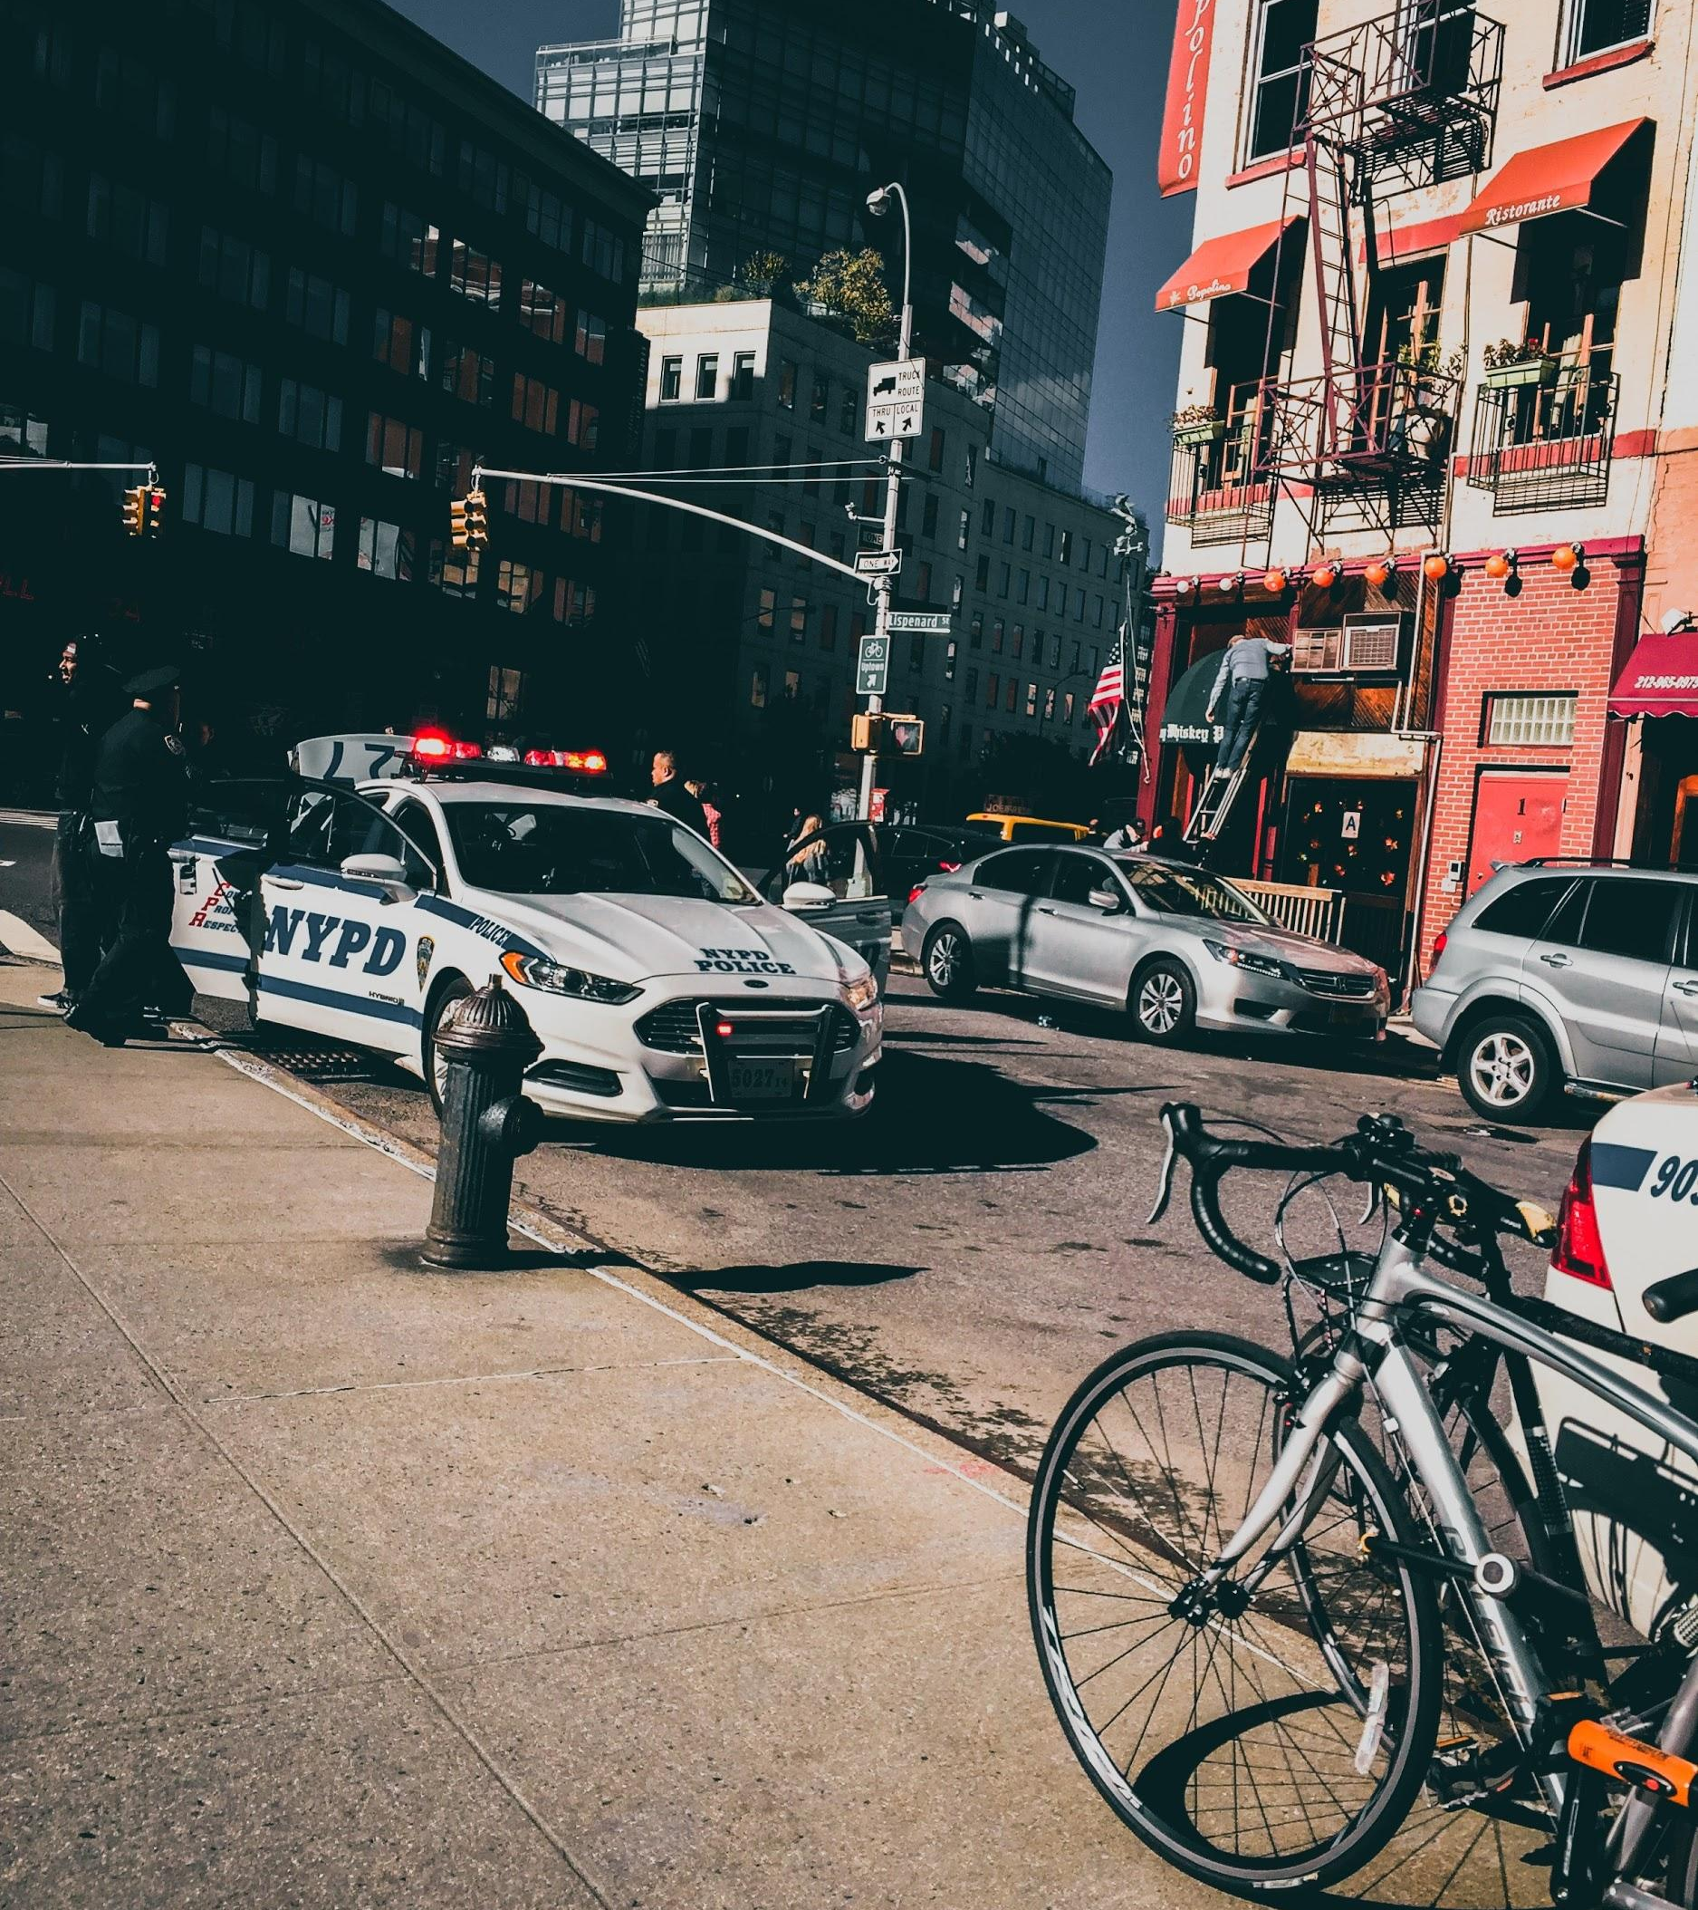
Problem Statement
Can Data help to explain and predict arrests in New York City?
DATA SOURCE: 2018, NYPD STOP & FRISK DATA

Slide 3
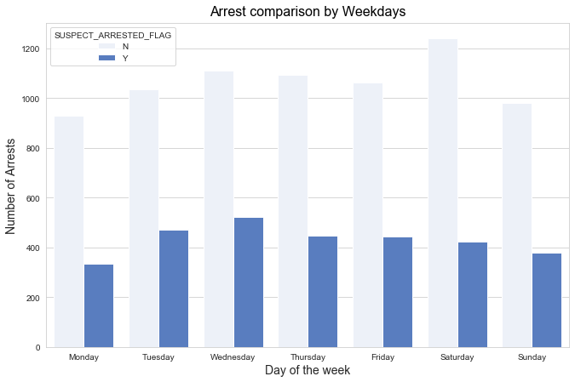

Slide 4
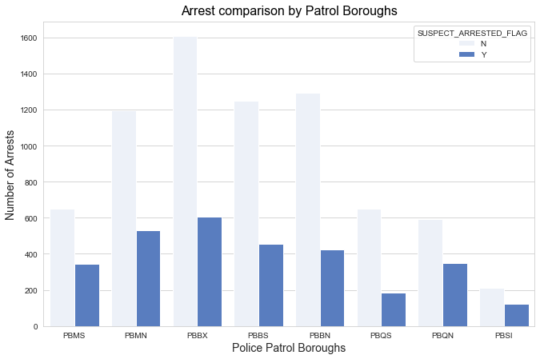

Slide 5
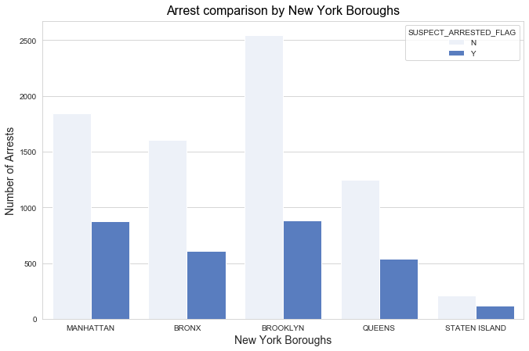

Slide 6
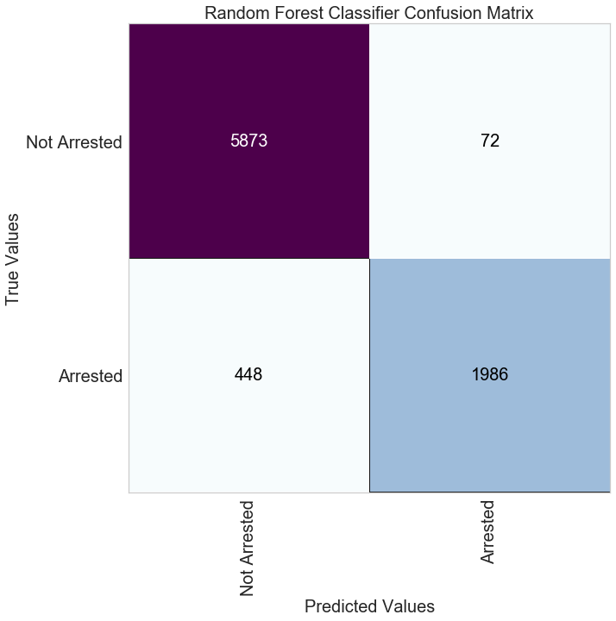
Model Results

Slide 7
Conclusions
Searches can lead to arrests
Avoid carrying weapons
While most stops happen in Brooklyn, evenings are peak arrest times

Slide 8
Further Exploration
These results are contingent upon the dataset and methods employed. Recommend additional features such as time and income.
With time, we seek to try additional models
Get balanced data from judiciary system and civil society

Slide 9
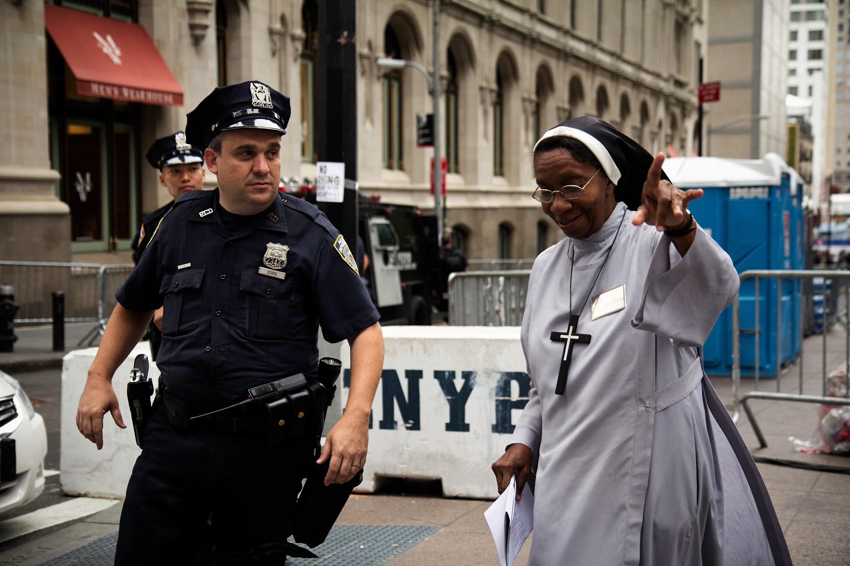
Questions ????

